Slide 1
Modeling the 2014 Ebola Outbreak
Math 470, Project 3
Josh Fontes & Zack Tweedy

Slide 2
The 2014 Ebola Outbreak
Beginning in West Africa, the 2014 outbreak of Ebola was the worst outbreak of Ebola in its' history.
Approximately 28,000 people became infected, with around 11,000 deaths.
The outbreak lasted from March 2014 through to June 2016. Several countries were involved, with the worst hit being Guinea, Liberia, and Sierra Leone.
Our project will be modelling this outbreak, using the information gathered from various sources and incorporating the SIR model.

Slide 3
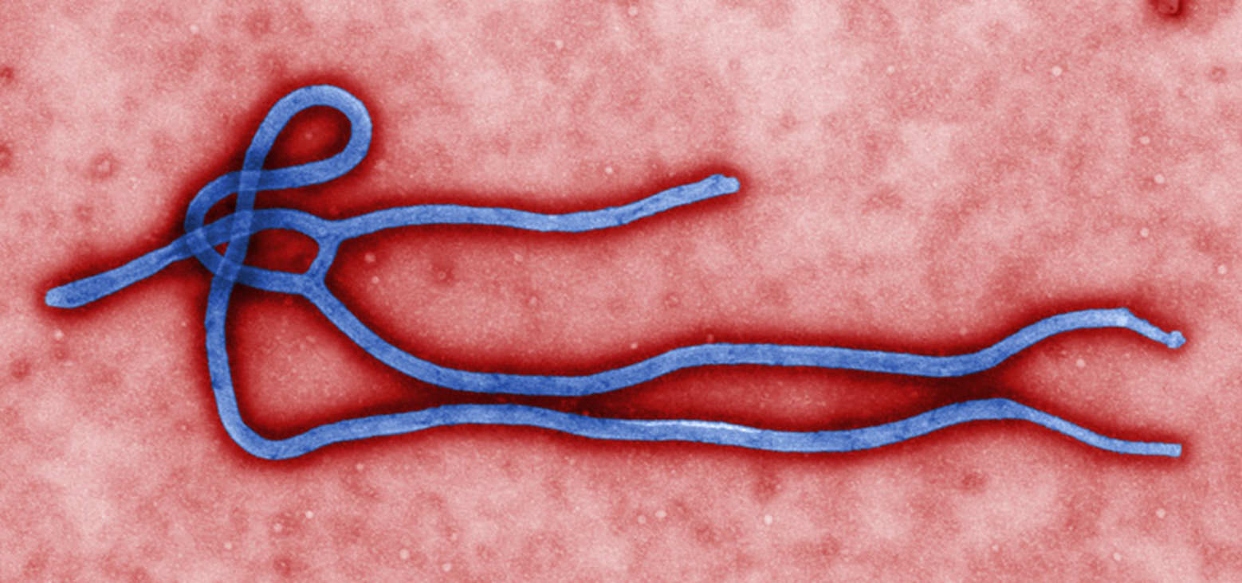
Background
The Ebola Virus Disease (EVD), formally known as Ebola Hemorrhagic Fever, is a severe and often fatal disease.
The disease is initially transmitted from humans contact with certain carriers of the disease, such as chimpanzees, fruit bats, gorillas, and other animals found in the forest. From there, transmission is based upon direct contact through blood, open wounds, and other fluids.

Slide 4
Background
The mortality rate is on average 50%, though in certain areas that mortality rate varies between 25% and 90%.
Symptoms include sudden onset of fever, fatigue, muscle pain, headache and sore throat. This is followed by vomiting, diarrhea, rash, symptoms of impaired kidney and liver function, and in some cases, both internal and external bleeding.
There is no vaccine, and no medicine. If you get this disease, the best thing for you is to hope that you survive. You will be provided with electrolytes and fluids, and recovery from this disease is dependent on good supportive care and your immune response.

Slide 5
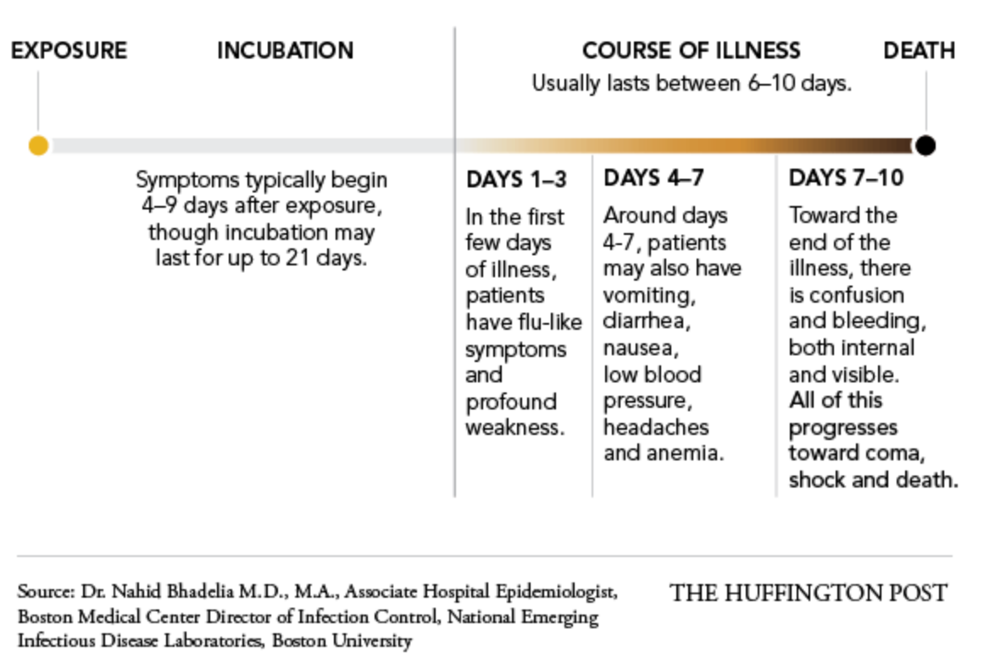
How the Disease Works

Slide 6
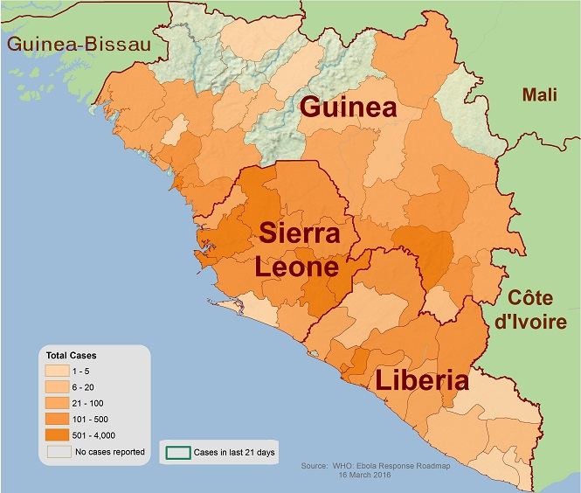
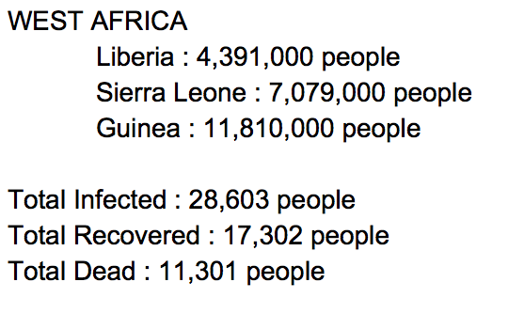

Slide 7
The SIR model
The SIR model (susceptible, infected, recovered) models the rate and spread of disease. It finds the number of people who can become infected with a contagious illness given a fixed total population over time.
Using differential equations, the rates of change for the Susceptible, Infected, and "Recovered" populations are modeled.
In our model, we are lumping together those who survived the virus and those who did not survive the virus together in the "recovered" population.

Slide 8
Assumptions
Independent variable is time “t” weeks
A number of people get infected every week (person moves from susceptible group to infected group)
A number of people will recover/perish every week (person moves from infected group to recovered group)
No one is added to the susceptible groups
No births or immigration is included

Slide 9
SIR model, Terms and Definitions
s(t) ; the susceptible fraction of the population.
i(t) ; the infected fraction of the population.
r(t) ; the recovered fraction of the population.
b ; the fixed number of contacts per day of an infected person with any other person.
k ; the fixed fraction of the infected group that could recover, on any given day.

Slide 10
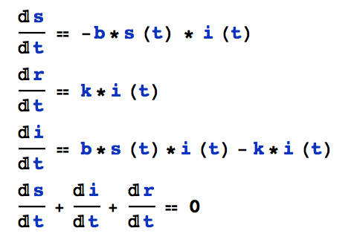
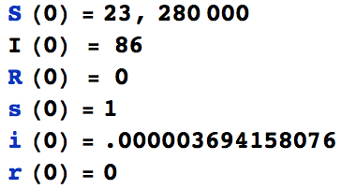
The Generalized SIR model

Slide 11
How We Developed Our Model
1) Gather initial values and data regarding the 2014 outbreak.
2) Using the data, created initial values and conditions for our equations.
3) Using Euler's Method, constructed recurrence equations from the differential equations in our initial findings.
4) Used Excel to plot the values and constructed graphs of each value over time.
5) Adjusted our parameter values (b,k) to best fit the data presented.
k value was chosen based on the average amount of time it takes to recover/perish from Ebola (8 days… so on any given week one person on average has a 7/8 chance of recovering)
b value was adjusted until our model accurately represented the actual data set on spread of Ebola

Slide 12
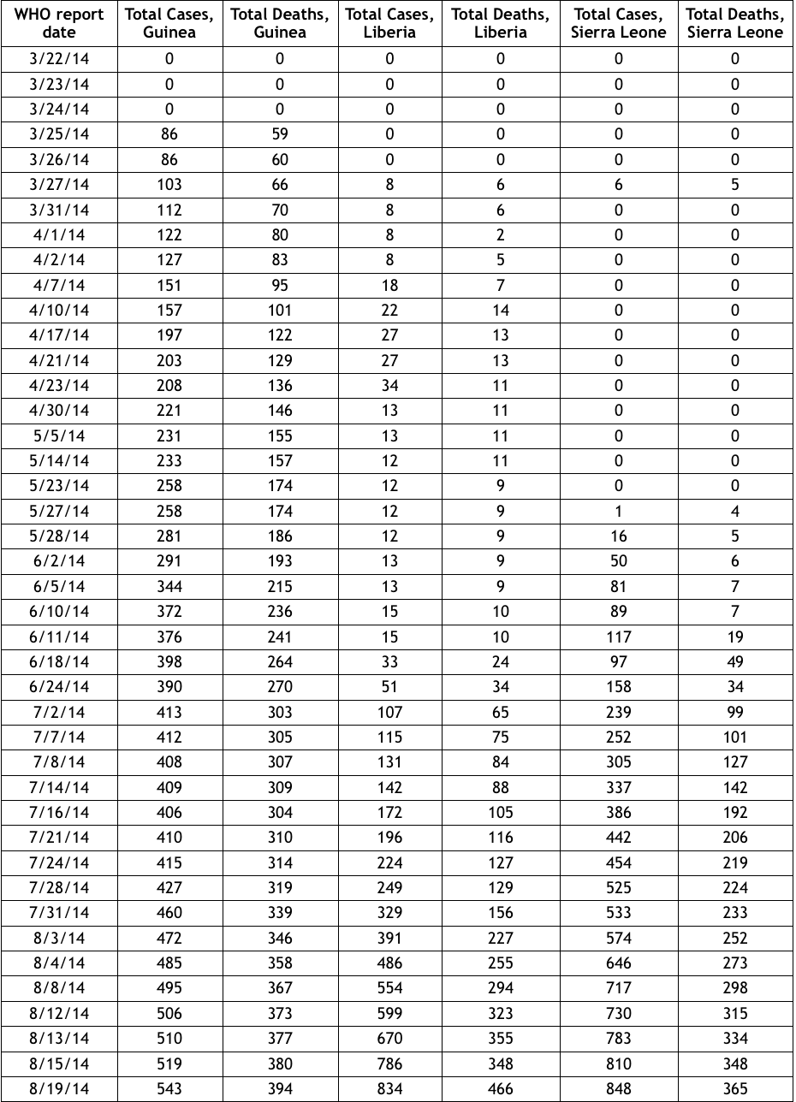
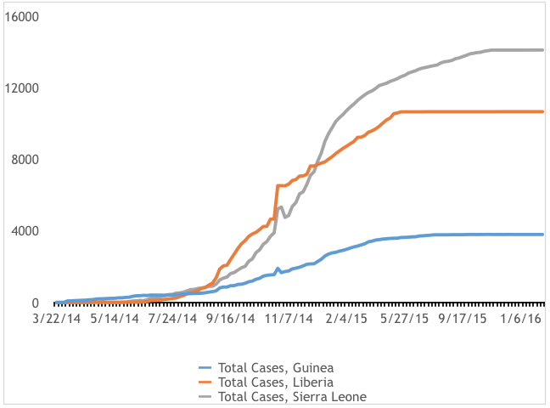
Pre-Model Data Collection
https://www.cdc.gov/vhf/ebola/outbreaks/2014-west-africa/cumulative-cases-graphs.html

Slide 13
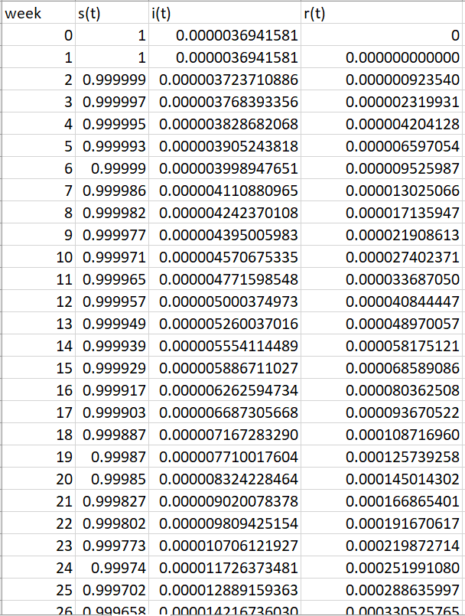
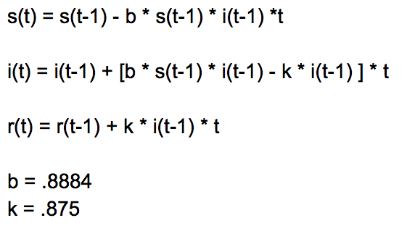
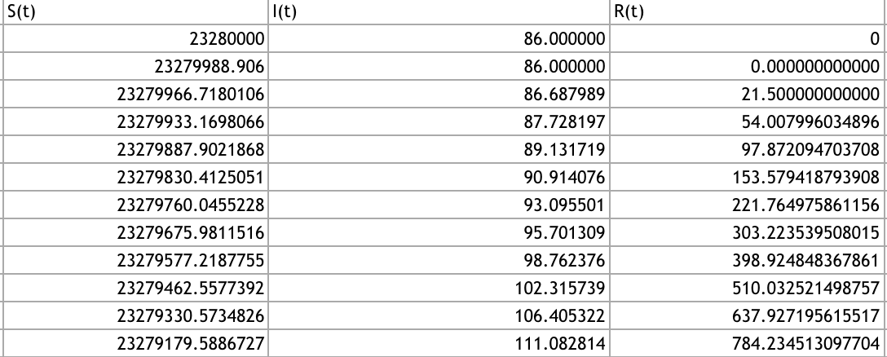

Slide 14
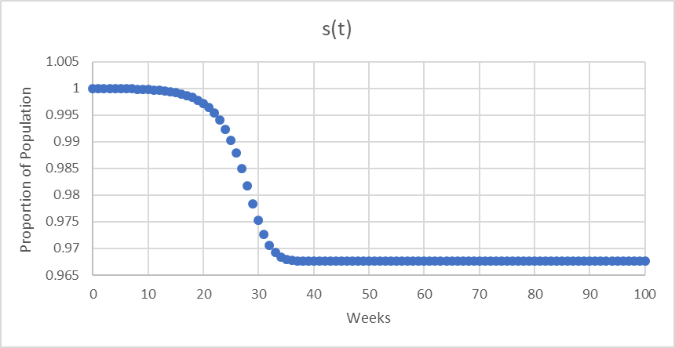
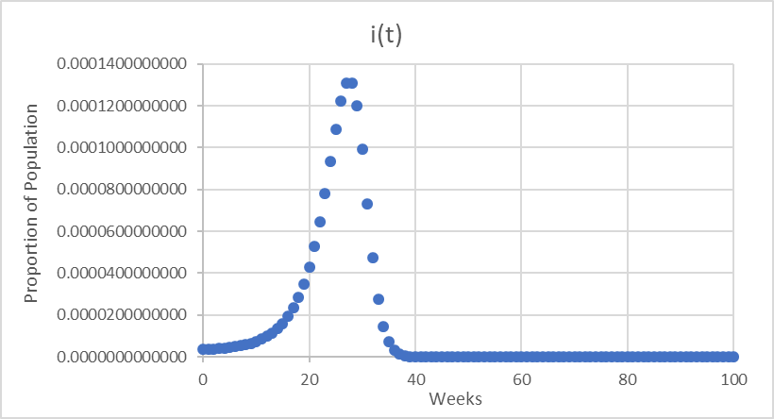
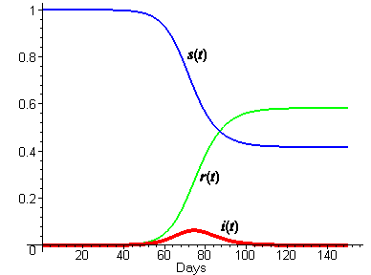
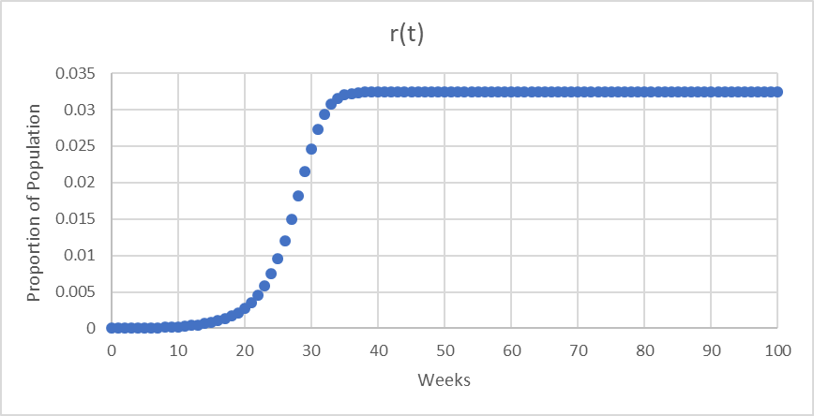

Slide 15
How They Managed Ebola & Limitations
Contrary to our model, Ebola only managed to infect 0.122% of the population in West Africa. Our model predicted 0.143%. What changed?
- High mortality rates made it difficult to model spread of Ebola
- Because there is no vaccine, avoidance of high probable transmission areas such as funerals and facilities where patients are being treated.
- Quarantining infected patients once they are infected.
- Avoidance of bats or nonhuman primates, and fluids / meats from these animals.
- Practice careful hygiene.

Slide 16
Bibliography
https://www.cdc.gov/vhf/ebola/outbreaks/2014-west-africa/cumulative-cases-graphs.html
https://www.maa.org/press/periodicals/loci/joma/the-sir-model-for-spread-of-disease-the-differential-equation-model
http://www.who.int/mediacentre/factsheets/fs103/en/
https://www.huffingtonpost.com/2014/08/02/ebola-symptoms-infection-virus_n_5639456.html

